Slide 1
Deploy Compute Resources (EC2, ECS, Lambda) Done by Sai Saran

Slide 2
AWS Lambda
AWS Lambda is a service provided by Amazon Web Services (AWS) that lets you run code without needing to manage servers. You simply write your code and upload it to AWS Lambda, and it automatically takes care of the rest, like running your code in response to specific events (like file uploads, database changes, or API requests).
IAM Role:
An IAM role in AWS (Identity and Access Management) is like a set of permissions that you can assign to users, applications, or services to let them access specific AWS resources or perform certain tasks.

Slide 3
Dynamo DB
Amazon DynamoDB is a fully managed NoSQL database service provided by AWS. It is designed to handle large amounts of data with high performance and low latency, making it ideal for applications that require quick access to data at scale.
Key Features of DynamoDB:
NoSQL
Managed Service
Scalable
Low Latency
Flexible Data Model

Slide 4
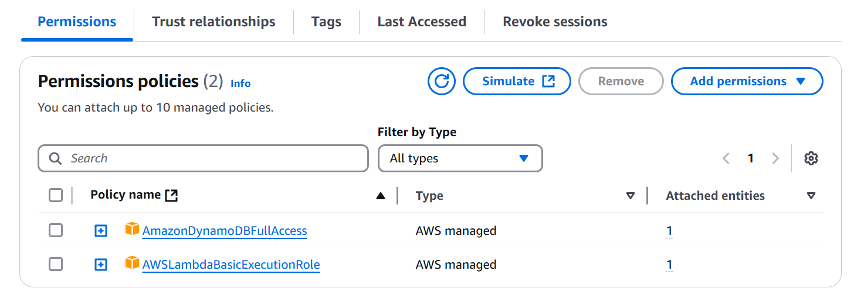
Deployment of Data base table in API
Step1: First create IAM Role and give the permissions policies for the below services
AmazonDynamoDBFullAcces
AWSLambdaBasicExecutionRole

Slide 5
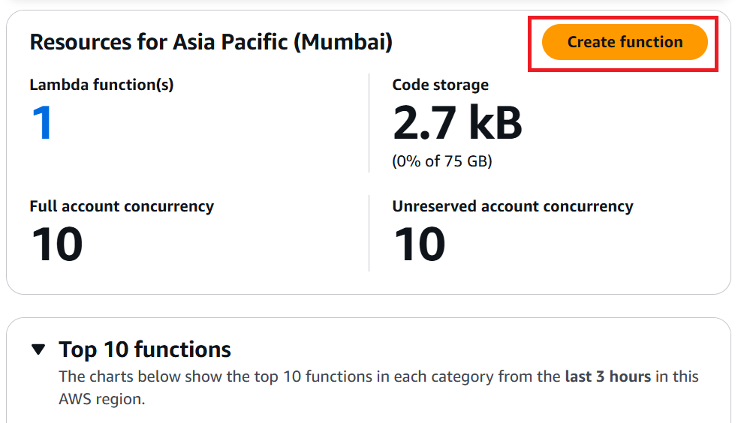
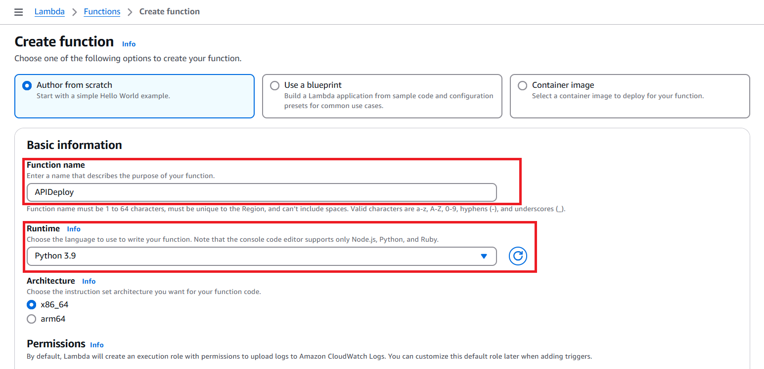
Step2: After Creating IAM role need to create a Function in AWS Lambda
In AWS Lambda service click on create function
Provide Function name and Runtime (Python 3.9)

Slide 6
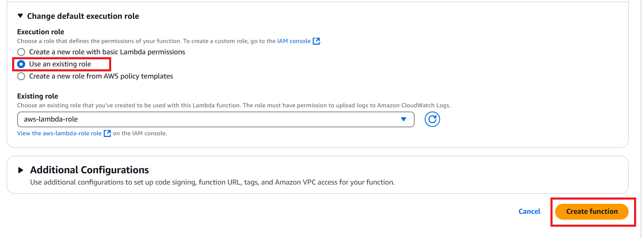
In Permissions select Execution rule as Existing role as IAM Role which was we created
Then click on create function

Slide 7
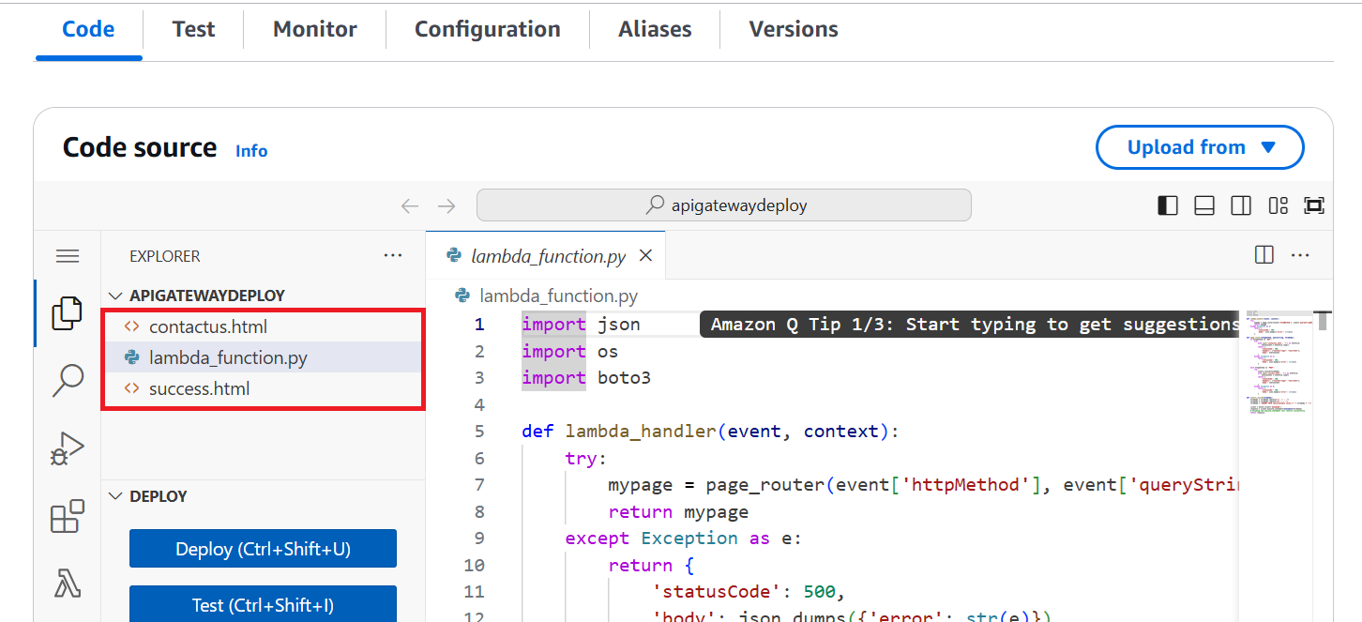
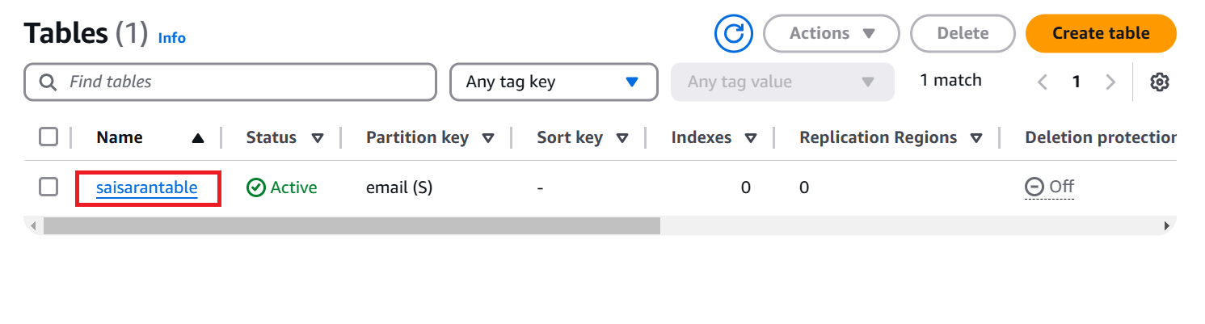
Step3: After creating the Function need to update the code to create a Database
Step4: Then Create Dynamo DB in AWS Service with name of table which was given the code

Slide 8
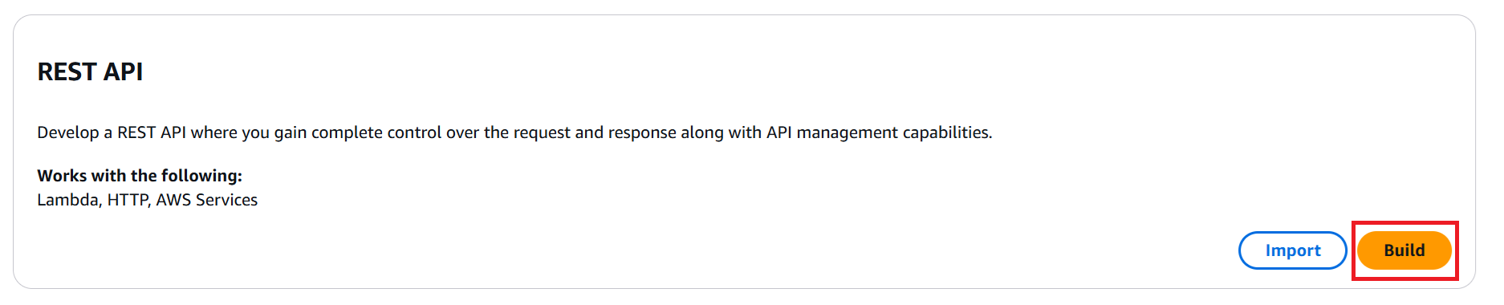
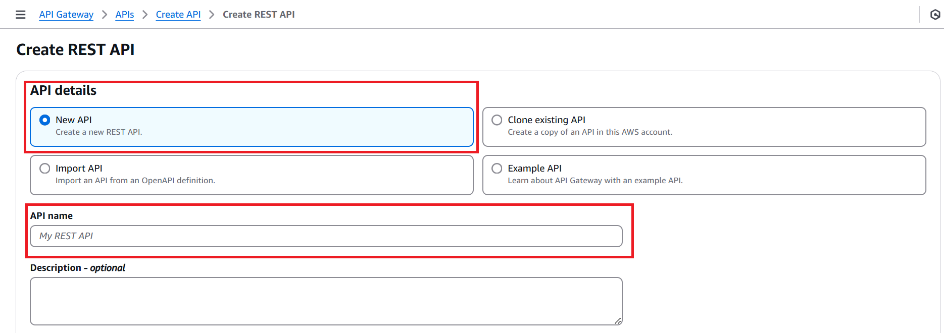
Step5: After Creating database need to deploy AWS lambda function in API for that we need to got API Service
In API Service select Reset API and then click on Build
Then select NEW API and provide the API Name

Slide 9
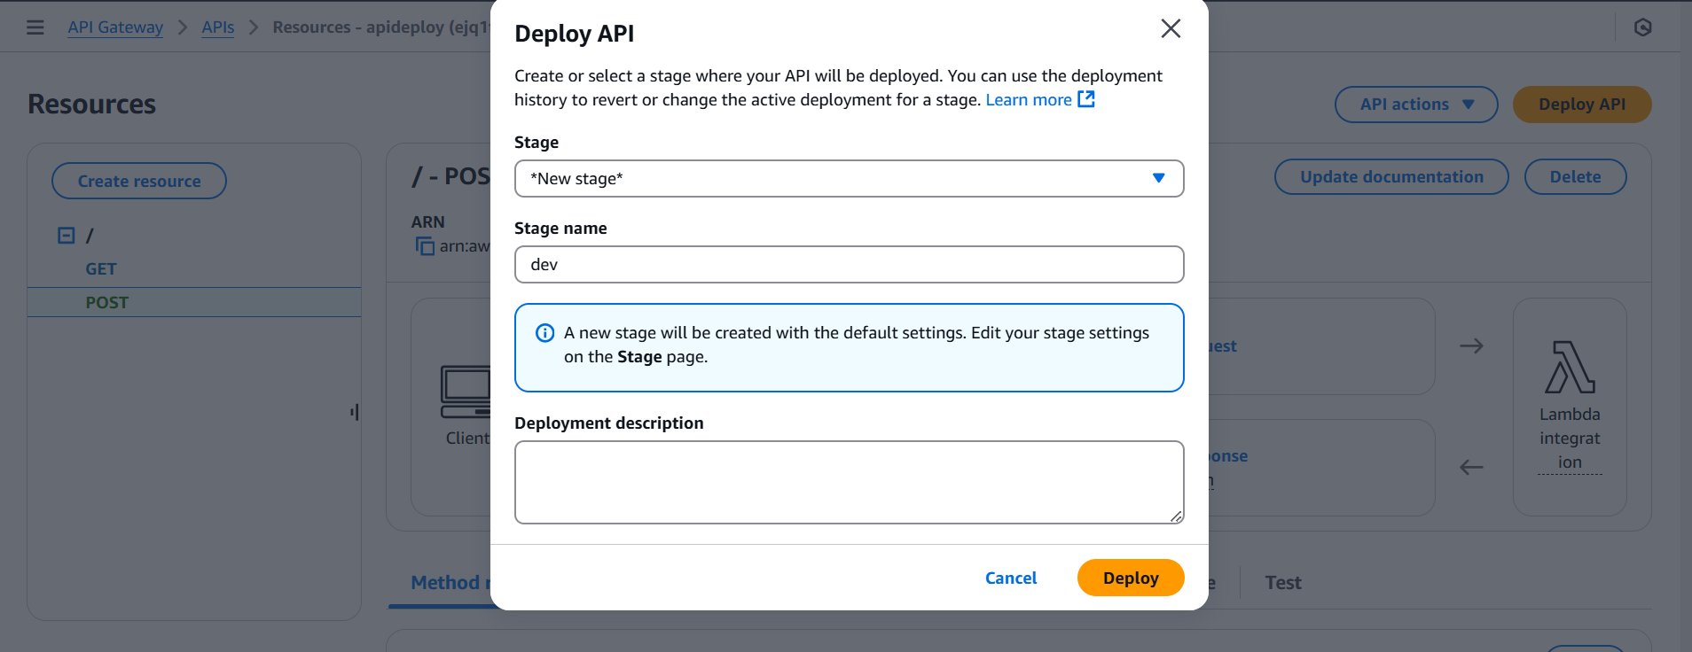
Step6: After Creating the API Need to Create two Methods with GET and POST
Step7: After creating the Methods need to Deploy the Post with new stage

Slide 10
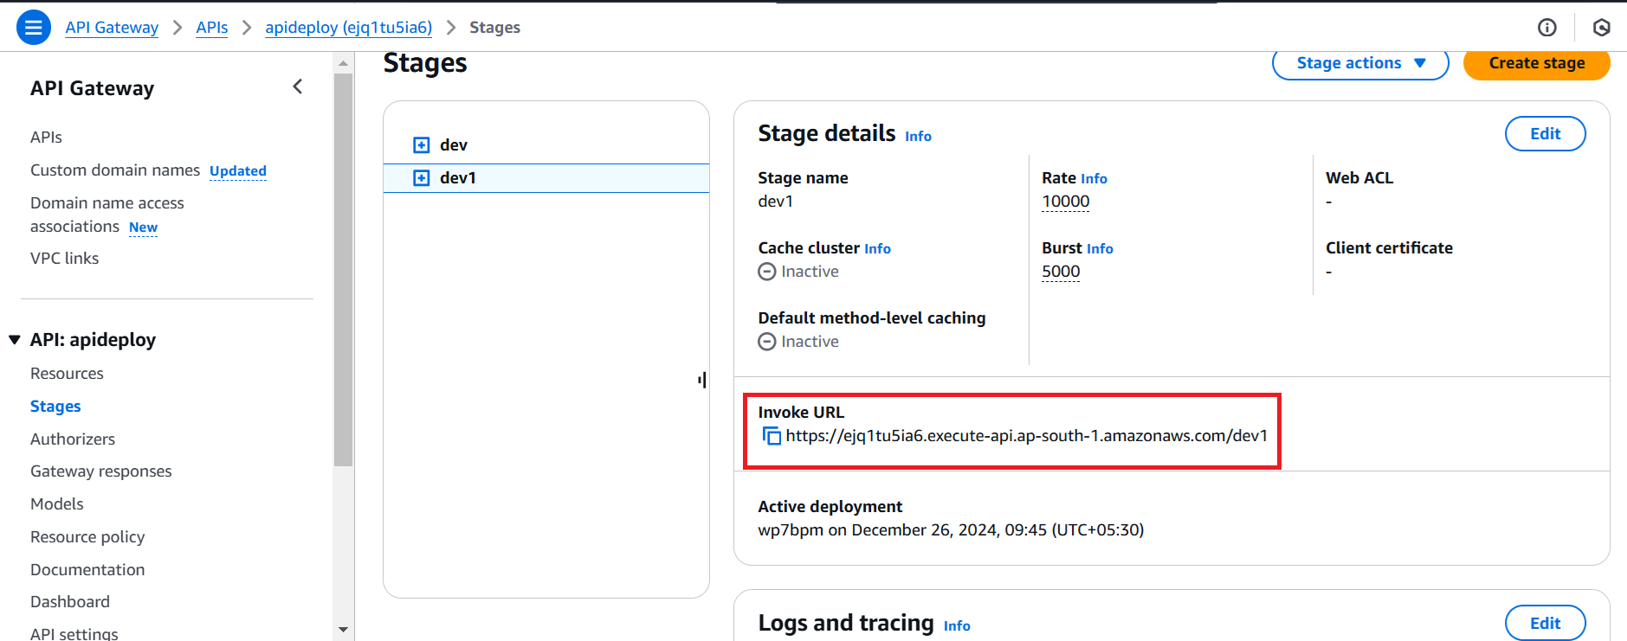
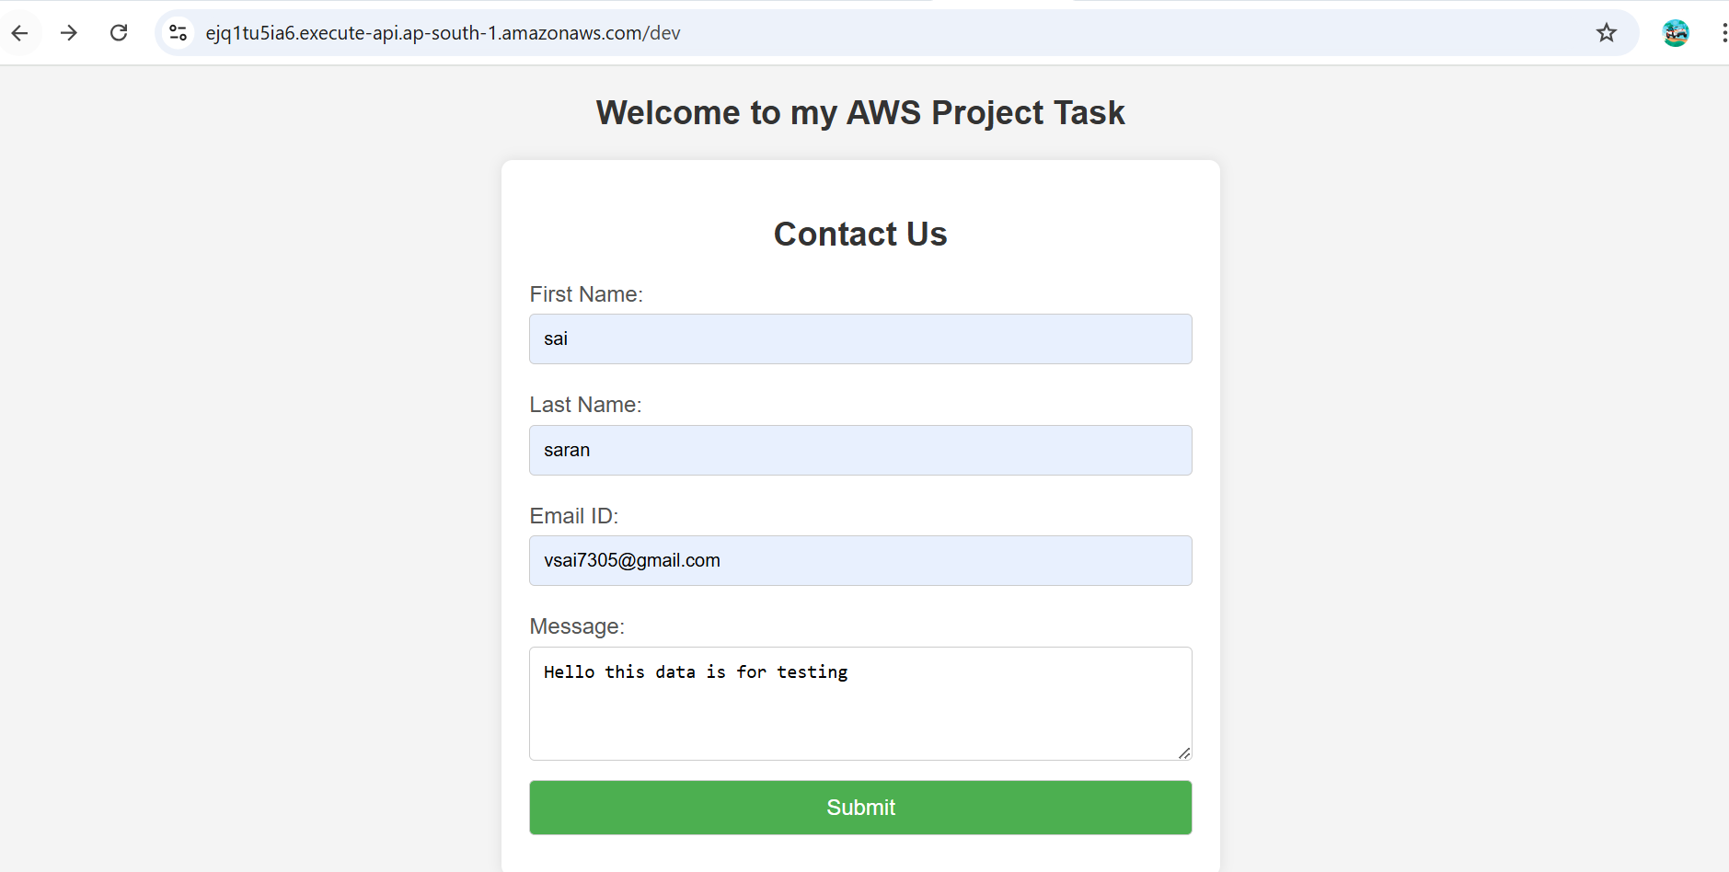
Step8: After deploying the post Invoke URL will be generated need to copy that link and past the link in chrome to check the Database is created or not

Slide 11
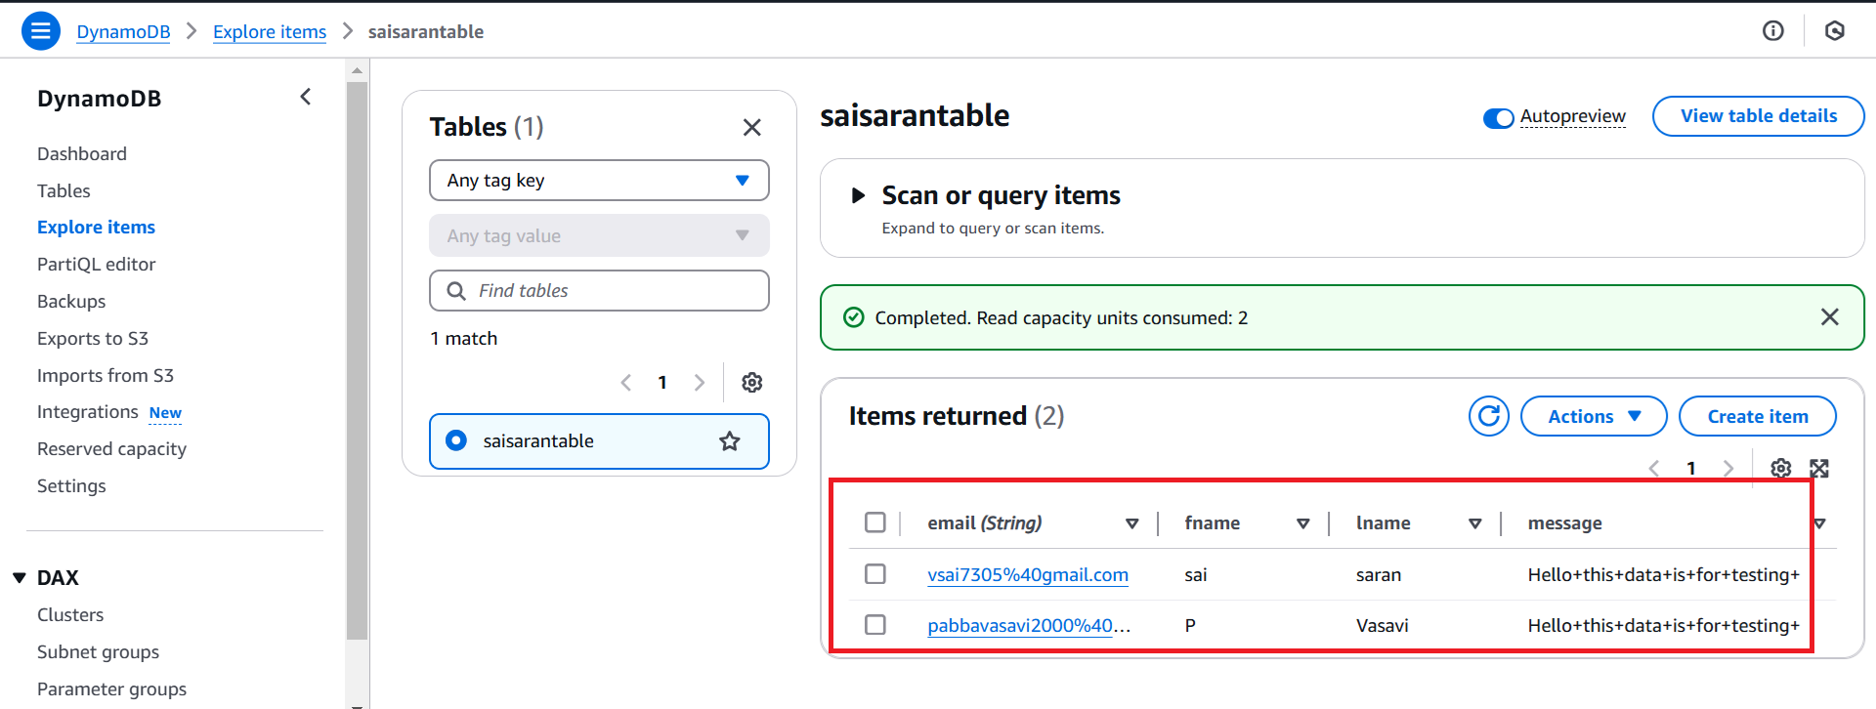
Step9: In the Web we need to enter the data after entering the data then click on submit the data will Reflect on Dynamo BD table which was created in AWS service

Slide 12
Elastic Container Service (ECS)
Amazon ECS (Elastic Container Service) is a fully managed service by AWS that allows you to easily run, manage, and scale Docker containers in the cloud. It simplifies the process of deploying containerized applications, ensuring that they run reliably and efficiently.
Fargate:
Amazon Fargate is a serverless compute engine for Amazon ECS (Elastic Container Service) and Amazon EKS (Elastic Kubernetes Service) that allows you to run containers without having to manage the underlying infrastructure.

Slide 13
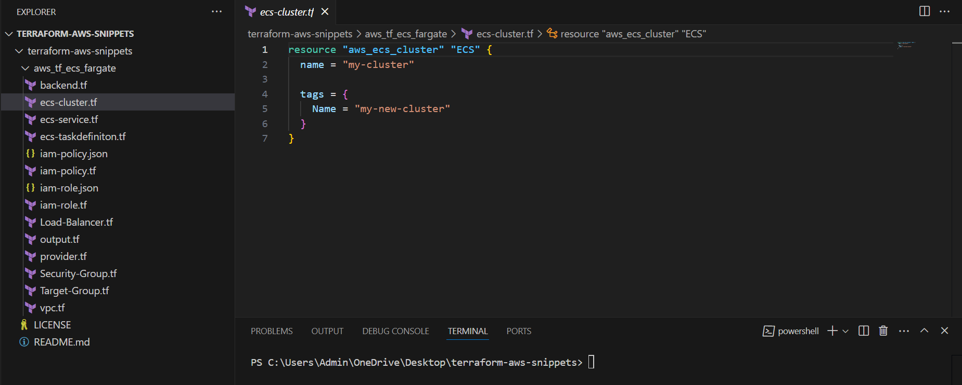
Creating ECS,Service,Fargate, Load Balancer and IAM Roles using Terraform
Need to Push the all terraform scripts form GitHub to VS code and then do the terraform init, Terraform Plan and terraform apply
GitHub URL For scripts
https://github.com/saisaran63/terraform-aws-snippets/tree/main/5.%20aws_tf_ecs_fargate

Slide 14
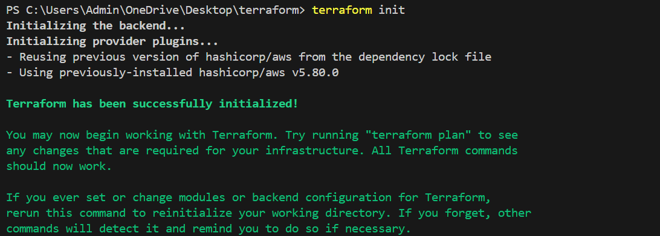
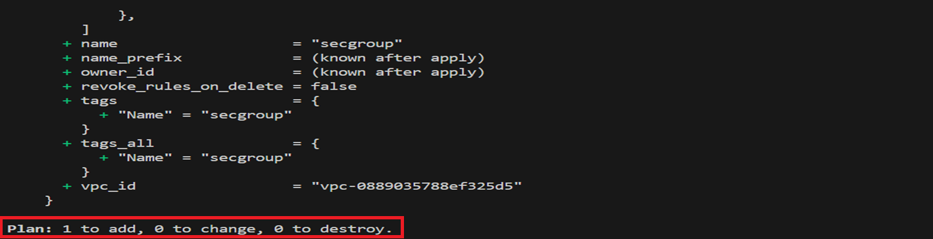
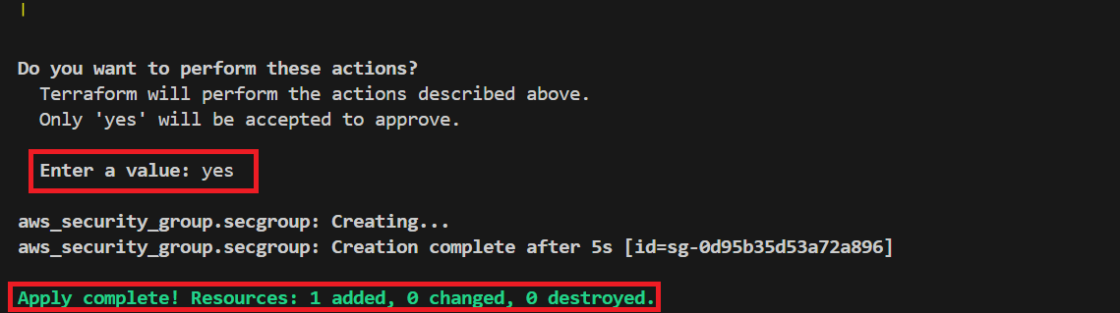
terraform init
terraform plan
terraform apply

Slide 15
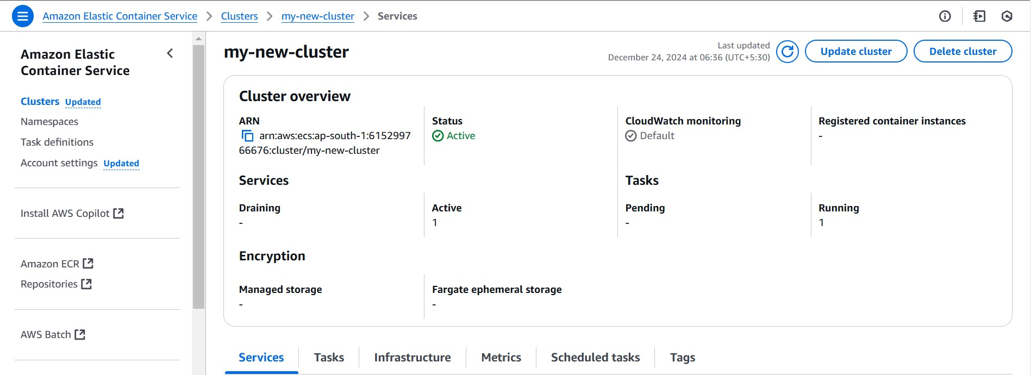
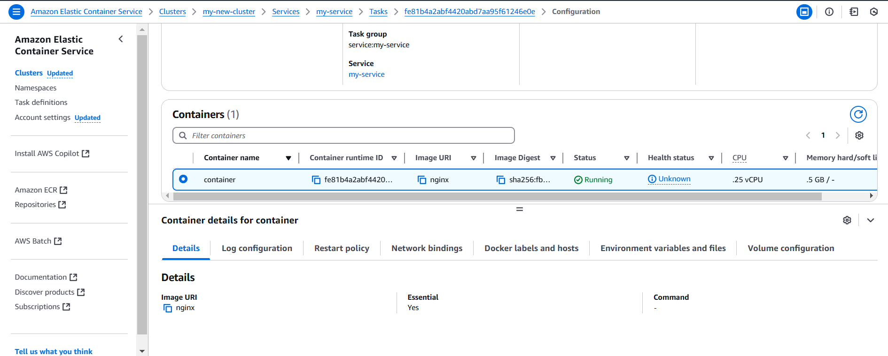
Cluster Console Output:

Slide 16
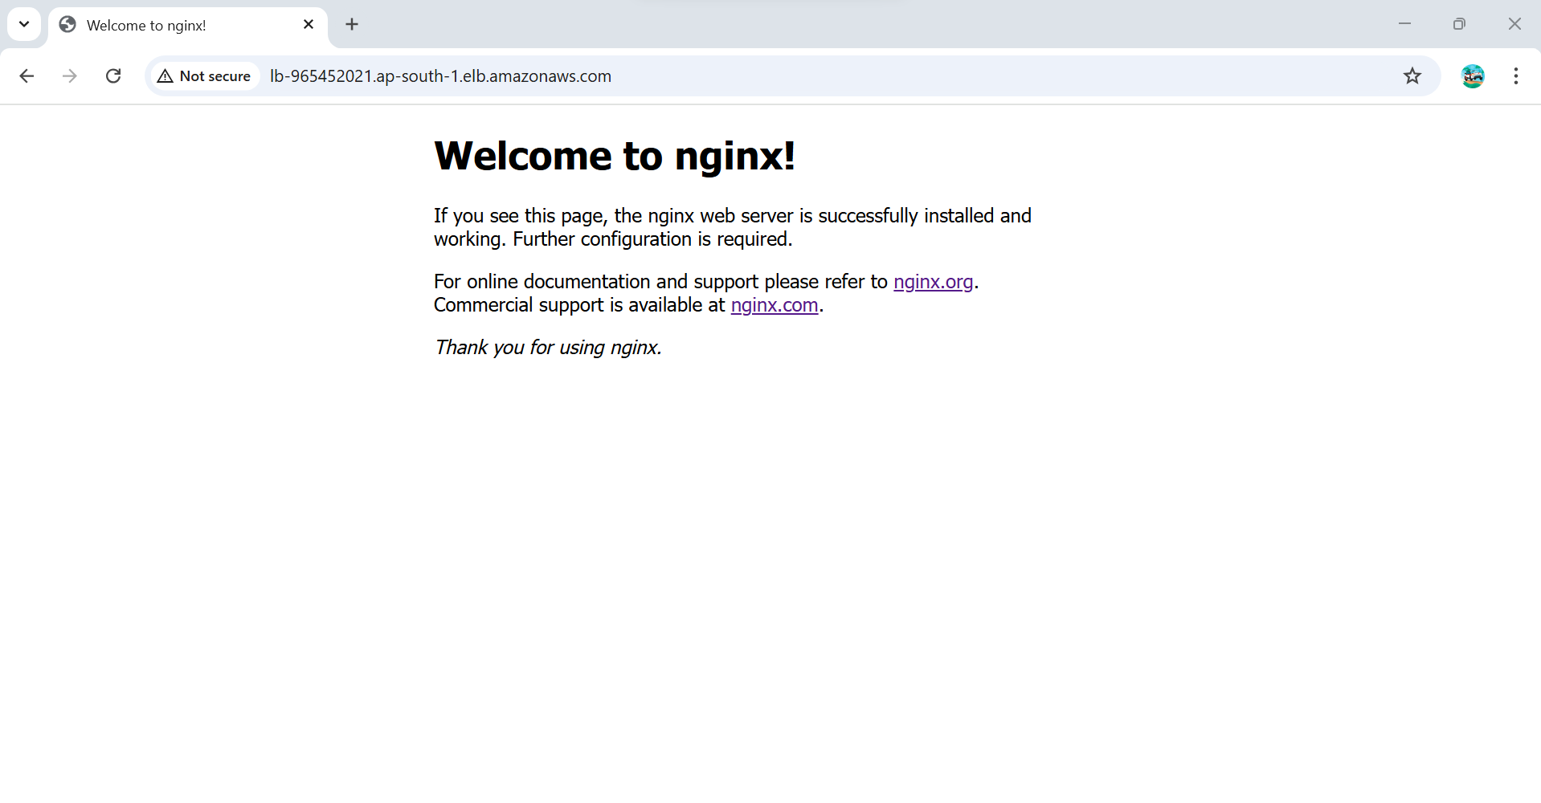
Ngnix Output

Slide 17


